Slide 1
Securing Flutter Apps
Sriram Saiteja

Slide 2
Who Am I?
An Information-Technology graduate.
Worked as a junior web-developer and currently working as a Data Analyst and mastering in Psychology part-time from IGNOU.
A Computer-Security and Data-Science enthusiast.
Helped OLA, a cab service in India find an vulnerability and suggest them ways to patch it.
Participated in various bug-bounties, helped small-time firms patch their security flaws.
Working towards my childhood dream of becoming a Writer and a Filmmaker.

Slide 3
What inspired me?
In 2009-2010, there was a silent cyber-war that was happening which excited me, literally picked me up by my collar and threw me to pursue Computer Security. I observed the news closely and slowly started exploring Programming and more about mechanics of computers and security.

Slide 4
ABSTRACT
Security has been really crucial in the current times.
From World Bank to the grocery mart, every transaction is being made on Mobile-Platforms and over Mobile-Apps.
In this session, we explore how we can build more resilient, secure and robust Flutter apps.
Other best practices for securing mobile applications in general.

Slide 5





SOME STATISTICS
5.20 billion devices owned world wide.
3-4 hours of average smartphone usage every day world-wide.
4.1 billion exposed records as of 2019 later half.
Hackers attack every 39 seconds on an average of 2244 times/day.
26% of general population don’t know what steps to take in the event of a data breach.

Slide 6
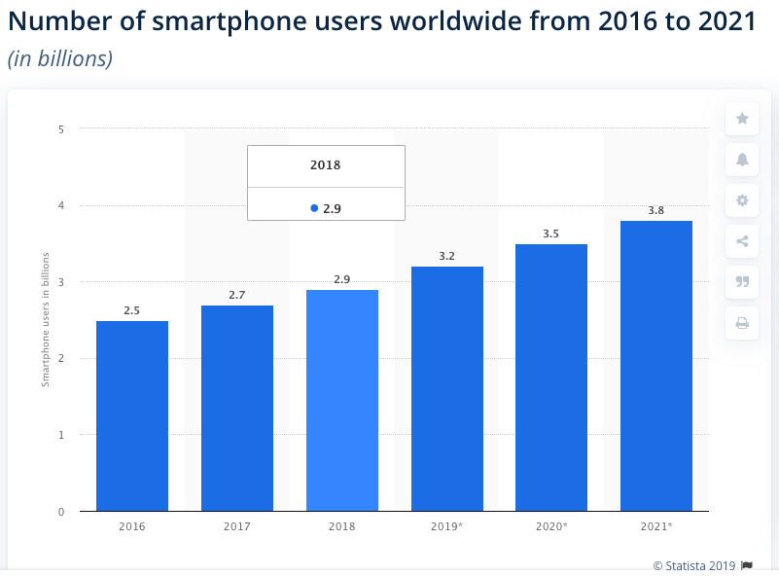
Source: https://leftronic.com/wp-content/uploads/2019/10/Screenshot-2019-12-20-at-14.37.12.png

Slide 7
TOP-10 MOBILE SECURITY RISKS ACCORDING TO OWASP
M1 - Improper platform usage.
M2 - Insecure data storage.
M3 - Insecure communication.
M4 - Insecure authentication.
M5 - Insufficient cryptography.
M6 - Insecure authorization.
M7 – Client code quality.
M8 - Code tampering.
M9 - Reverse engineering.
M10 - Extraneous functionality.
Source: https://owasp.org/www-project-mobile-top-10/
Source: https://blog.pradeo.com/owasp-top-10-mobile-app-development-best-practices

Slide 8
M1 - IMPROPER PLATFORM USAGE
Not following the documentation properly exposes the apps to risks.
To prevent those, developers are advised to practice secure coding and configuration on the server-side of the mobile application.
As a result, security breaches often occur from the failure to use or the misuse of Android intents, iOS Touch ID, iOS Keychain and other security functionalities.
Example: Citrix Worx Apps.

Slide 9
M2 – INSECURE DATA STORAGE
From a security point of view, applications should not be designed to store sensitive information on the end-user side such as SD Cards, applications files or local SQLite databases, especially when unencrypted.
Besides, this category also encompasses bad practices such as having sensitive information written in the application logs, in the applications memory or its decompiled code, which of course should never be done.
EXAMPLES: TINDER exposed user locations.

Slide 10
M3 – INSECURE COMMUNICATION
A mobile application usually exchanges data with several servers. When these communications over the network are not encrypted nor correctly authenticated (poor handshaking, incorrect SSL versions, weak negotiation, clear text communication, etc.), they can be intercepted by third parties.
In the case of applications handling personal data (banking, health, public service…), these vulnerabilities represent a failure to comply to data privacy laws.
On the other hand, when found in apps related to connected objects (home automation, security camera, smart cars…), they can lead to control takeover.
EXAMPLE: MiSafe watches for kids revealed location, user-ids etc.,

Slide 11
M4 – INSECURE AUTHENTICATION
This category covers the authentication of end-users and bad session management. In mobile apps unlike in web apps, users are not always online.
Hence mobile apps must be able to identify the user and maintain its identification along its session, when both online and offline.
When cybercriminals identify inexistent or weak authentication scheme in mobile apps, they create malwares that will bypass them. Strong user authentication that leverages multiple factor prevents them from accessing users’ data.
EXAMPLE: Grab Android app’s 2FA was bypassed because of lack of code expiration.

Slide 12
M5 – INSUFFICIENT CRYPTOGRAPHY
Insecure use of cryptography is common among mobile apps leveraging encryption. It can come from flawed process or encryption algorithms that are weak by nature.
In both cases, someone can exploit the vulnerability to decrypt sensitive data handle by the apps. Developers should make sure to apply the latest cryptographic standards that will withstand the test of time.
EXAMPLE: Kaspersky recognized several apps vulnerable because of third party SDK’s.

Slide 13
M6 – INSECURE AUTHORIZATION
Some apps, after authenticating users, grant them some authorizations by default. These authorizations are sometimes mistakenly too extended, providing users with rights they should not have.
If a cybercriminal gets access to privileged rights in an application, it can result in unlawful access to sensitive information, the deletion of entire systems or even the takeover of connected objects.
The spectrum of authorizations granted to users should be assessed prior apps are released.
EXAMPLE: VIPER SMART START app basically helped hack into cars with just a mobile device.

Slide 14
M7 – CLIENT CODE QUALITY
This category includes vulnerabilities like buffer overflows, format string vulnerabilities, and various other code-level mistakes that allow code to be executed on mobile devices.
In case of a buffer overflow for instance, it is possible to write into areas known to hold executable code and replace it with malicious code, or to selectively overwrite data pertaining to the program's state.
Most code issues can be fixed with good practices. Having code patterns across your organization that are easy to read and come with clear documentation is a good start to reduce this risk.
If a cybercriminal gets access to privileged rights in an application, it can result in unlawful access to sensitive information, the deletion of entire systems or even the takeover of connected objects.
EXAMPLE: Spyware installed on WhatsApp by exploiting WhatsApp 0 day flaw through calling WhatsApp users.

Slide 15
M8 – CODE TAMPERING
Tampering consists of duplicating an application, adding one or several back doors to its code, re-signing it and publishing it to third-party app stores.
Tampered apps are often referred to as malicious clones, and usually target banking and very popular apps. Thanks to the back doors, hackers are able to intercept data and even sometimes impersonate official apps to communicate with companies’ servers.
To prevent this risk, developers should use anti-tampering solutions and enable apps with capabilities to detect tampering.
Permission to receive messages: android.permission.RECEIVE_SMS
Permission to send messages: 'android.permission.INTERNET' or 'android.permission.SEND_SMS'
EXAMPLE: Postbank Finanzassistent.

Slide 16
M9 – REVERSE ENGINEERING
To reverse engineer an app, an attacker analyzes its binary code to determine its source code, libraries, algorithms and any other asset.
By providing deeper knowledge on the app, this technique enables hackers to identify its flaws and exploit it more easily.
Reverse engineering can result in the theft of intellectual property, information about backend servers, cryptographic ciphers, etc.
To minimize this risk, developers must write complex code and use obfuscation.
EXAMPLE: Reverse engineering the geolocation service and serving it false geodata, players were able to “control” their character in-game, ignoring the app’s basic premise of capturing Pokémon in the player’s immediate vicinity and instead allowing players to travel across the world, hatching eggs in minutes rather than hours.

Slide 17
M10 – EXTRANEOUS FUNCTIONALITY
During development cycles, developers often include hidden backdoors or security controls to their apps to detect and correct flaws.
These functionalities are not supposed to remain in production environment, but sometimes accidently get forgotten.
When identified by hackers, these features can be exploited to access sensitive data or escalate privileges.
Before releasing an application, developers need to review configurations and should disable debug logs.
EXAMPLE: WiFi transfers left sensitive ports open which left millions of apps on play store vulnerable.

Slide 18
SECURING FLUTTER APPS
Preventing screenshots is one of the most important feature of security we need to inculcate in our apps, especially if it’s media based application.
FLAG_SECURE is used to prevent the privacy when the app window is minimized generally.
But with the introduction of Flutter’s Window Manager, FLAG_SECURE also prevents screenshots.
Example: await FlutterWindowManager.addFlags (FlutterWindowManager.FLAG_SECURE);
Package: import 'package:flutter_windowmanager/flutter_windowmanager.dart';

Slide 19
SECURING FLUTTER APPS
CODE-OBFUSCATION:
Code obfuscation is the process of modifying an app’s binary to make it harder for humans to understand.
To Obfuscate use:
flutter build apk --obfuscate --split-debug-info=/<project-name>/<directory>
To reduce App’s size use:
--split-debug-info flag.
To read Obfuscated app’s stack trace use:
flutter symbolize -i <stack trace file> -d /out/android/app.android-arm64.symbols

Slide 20
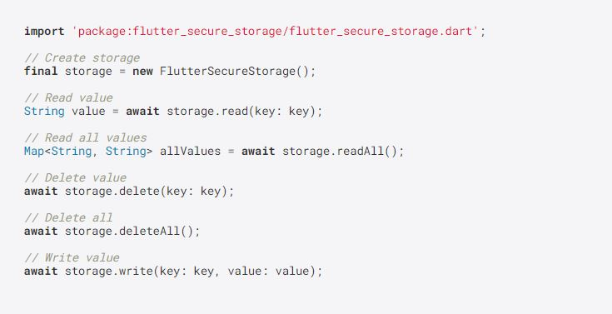
SECURING FLUTTER APPS
A Flutter plugin to store data in SECURE STORAGE:
Keychain is used for iOS
AES encryption is used for Android. AES secret key is encrypted with RSA and RSA key is stored in KeyStore
Note KeyStore was introduced in Android 4.3 (API level 18). The plugin wouldn't work for earlier versions.

Slide 21
SECURING FLUTTER APPS
ENFORCING STRONG ENCRYPTION METHODS WITH CRYPTO
A set of cryptographic hashing functions implemented in pure Dart
The following hashing algorithms are supported:
SHA-1
SHA-224
SHA-256
SHA-384
SHA-512
MD5
HMAC (i.e. HMAC-MD5, HMAC-SHA1, HMAC-SHA256)
Source: https://pub.dev/packages/crypto

Slide 22
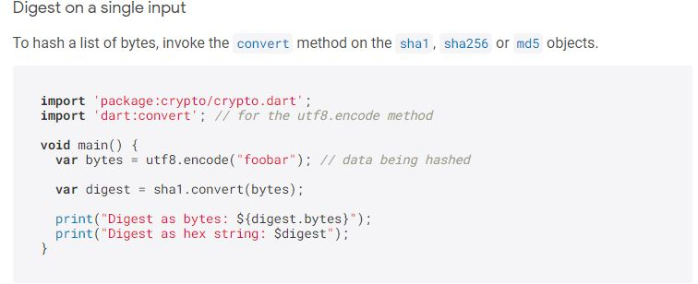
SECURING FLUTTER APPS

Slide 23
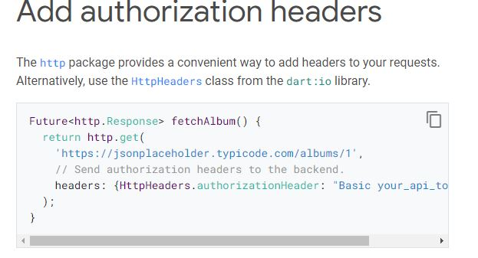
SECURING FLUTTER APPS
Make authenticated requests:
To fetch data from most web services, you need to provide authorization. There are many way to do this, but perhaps the most common uses the authorization HTTP header.
Source: https://flutter.dev/docs/cookbook/networking/authenticated-requests

Slide 24
SECURING FLUTTER APPS
SHARED PREFERENCES:
Suppose you wanna save a small value (a flag probably) that you wanna refer later sometime when a user launches the application. Then shared preference comes into action.
We do not use SQLite for saving small values because then you will need to write lengthySuppose you wanna save a small value (a flag probably) that you wanna refer later sometime when a user launches the application. Then shared preference comes into action.
We do not use SQLite for saving small values because then you will need to write lengthy codes and supporting classes.
Shared Preference let you read and write key-value pair in a couple of lines easily. But always remember, shared preference is not a solution for you to keep complex relational data. codes and supporting classes.
Shared Preference let you read and write key-value pair in a couple of lines easily. But always remember, shared preference is not a solution for you to keep complex relational data.

Slide 25

THROW AWAY THE TECH GIBBERISH!
SECURITY IS A LIFESTYLE AND A WAY OF LIFE!
ONE THAT MEETS THE EYE.
ONE THAT MEETS THE MIND.
ONE THAT IS INVISIBLE TO BOTH EYE AND MIND!

Slide 26

FROM HERE ON:
MY SOURCES OF INSPIRATION AND LEARNING RESOURCES:
OWASP.
MEDIUM.
STACKOVERFLOW.
THE BIGGEST OF ALL, “GOOGLE”
OFFENSIVE WEB SECURITY
CEH
CompTIA NETWORK+ and SECURITY+

Slide 27
Social Engineering bypasses all technologies, including firewalls! - Kevin Mitnick

Slide 28
PLEASE WEAR YOUR MASK
COVID-19 is an invisible enemy! Only way to save ourselves is to adapt a lifestyle, instead of chasing cures.

Slide 29
Special thanks Anna for choosing me and support throughout! Thanks to Nik and the whole team of Geekle.

Slide 30
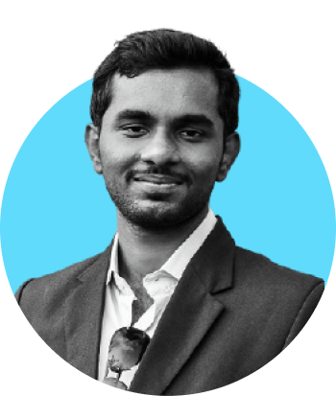
Thank You!
sriramsaitejaofficial@gmail.com
Facebook.com/SriramSaitejaOfficial2
https://twitter.com/SriramSaiteja/
Instagram.com/sriram.saiteja
This slide is an editable slide with all your needs.
https://www.linkedin.com/in/sriram-saiteja-4290b6112/
+919346410791
GET THE SLIDES AT:

